Slide 1


Hii, Iam Siddhika
Welcome to Power BI Series
Part -7

Slide 2

Today Content
Continuation of
Power Query
PIVOTING UNPIVOTING TRANSPOSE
Come Let’s Go

Slide 3
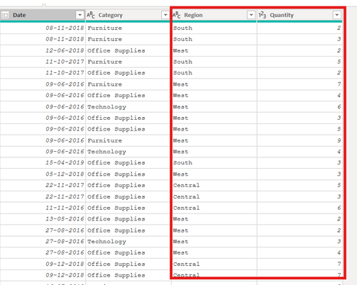


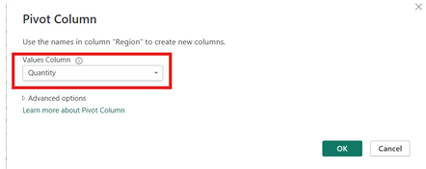
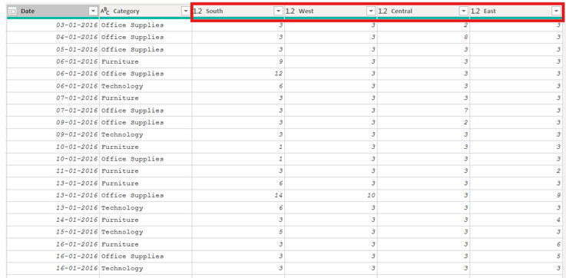
Power Query
Pivoting describes the process of turning distinct row values into columns.
Here we are converting Region row Values to columns based on the quantity values using Pivot by selecting Region and quantity columns
PIVOTING :
Have you Pivoted?

Slide 4

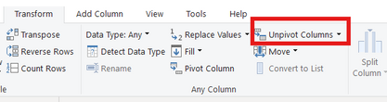
UNPIVOTING
It is Opposite to PIVOT
unpivoting describes the process of turning distinct columns into rows
Here we are converting by selecting Columns - South,West,Central, East to Rows using UNPIVOT

Slide 5
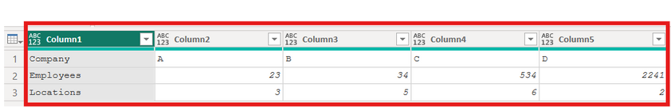

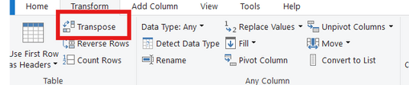
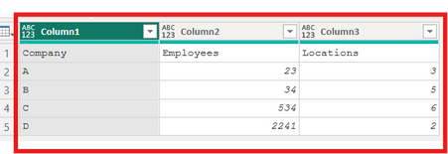
TRANSPOSE
Transpose works very similarly, but doesn’t recognize unique values; instead, the entire table is transformed so that each row
becomes a column and vice versa
Have you got it?
Here Rows Company, Employees, Locations converted to Columns by using TRANSPOSE

Slide 6

Thank you for joining me today to learn about Part -7 of Power BI!
Remember, With techniques like pivoting, unpivoting, and transposing, you can transform your data dynamically to suit your analysis needs.
Stay tuned for more insights and tips on Power BI in our next Series.
Follow
Siddhika Shah

